Slide 1

Garbage Image Classification using Computer Vision
This project automates the classification of waste materials into categories like plastic, paper, metal, and organic, utilising advanced deep learning and computer vision techniques. Our core objective is to improve the precision and efficiency of waste sorting, contributing significantly to sustainable waste management initiatives.

Slide 2

Comprehensive Dataset for Robust Training
Our dataset is meticulously curated from a bespoke folder hosted on Google Drive. It comprises a diverse collection of labelled images, categorised into ten distinct waste classes: battery, biological, cardboard, clothes, glass, metal, paper, plastic, shoes, and general refuse.
Images undergo rigorous preprocessing, including resizing and normalisation, to ensure consistency and optimal model performance.
The dataset is strategically split, with 80% allocated for training and the remaining 20% reserved for validation.
To mitigate class imbalance and enhance model generalisation, comprehensive augmentation techniques are applied during training.

Slide 3




Sophisticated Deep Learning Models Employed
We have harnessed the power of two distinct deep learning architectures, each tailored for effective waste classification, demonstrating versatility and performance.
MobileNetV2 (Keras)
EfficientNetB0 (Keras)
Lightweight, pre-trained via transfer learning. Fine-tuned on our dataset using Keras ImageDataGenerator.
State-of-the-art pre-trained model, balancing high accuracy with fewer parameters. Trained and validated identically to MobileNetV2.

Slide 4
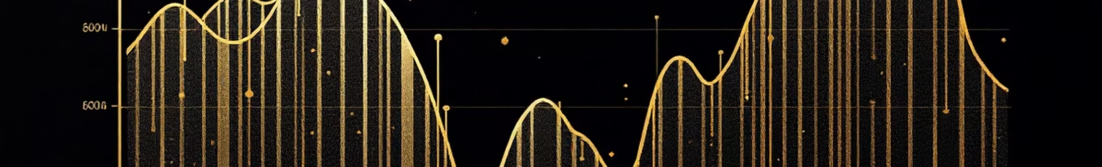
Rigorous Training and Performance Evaluation
Our models underwent meticulous training and evaluation to ensure optimal performance and reliability in waste classification.
Optimiser
Regularisation
Models were trained using the Adam optimiser for efficient convergence and robust gradient descent.
EarlyStopping with ModelCheckpoint was implemented to prevent overfitting and save the best performing model weights.
1
2
3
4
Loss Function
Visualisation
Categorical cross-entropy was chosen as the loss function, ideal for multi-class classification tasks.
Comprehensive training histories, including accuracy and loss curves for both MobileNetV2 and EfficientNetB0, were plotted for detailed analysis.

Slide 5

Strategic Model Preservation
To facilitate seamless deployment and future accessibility, our trained models are preserved using industry-standard formats.
.h5 Format
Models could be saved in the highly portable .h5 format, ensuring readiness for diverse deployment environments, including web applications.
.pkl (Pickle)
While not used, it's noted that .pkl is generally less ideal for Keras models compared to native Keras saving formats, due to potential compatibility issues.
.keras (Keras)
The modules in this program are saved using .keras format that is most conducive to storing files belonging to the tensorflow library in python.

Slide 6
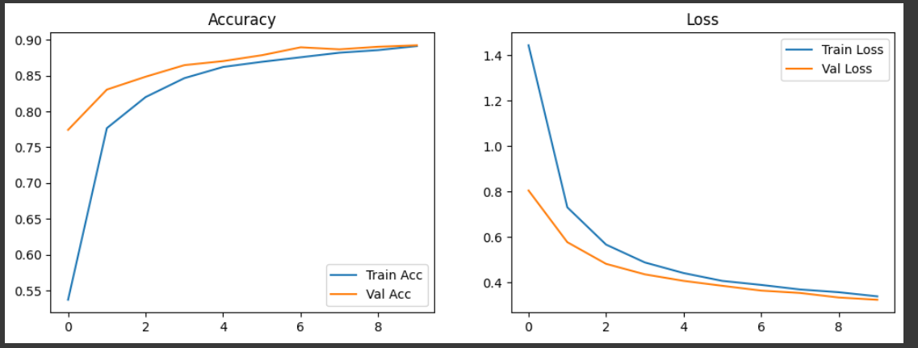
MobilenetV2 Accuracy Prediction

Slide 7
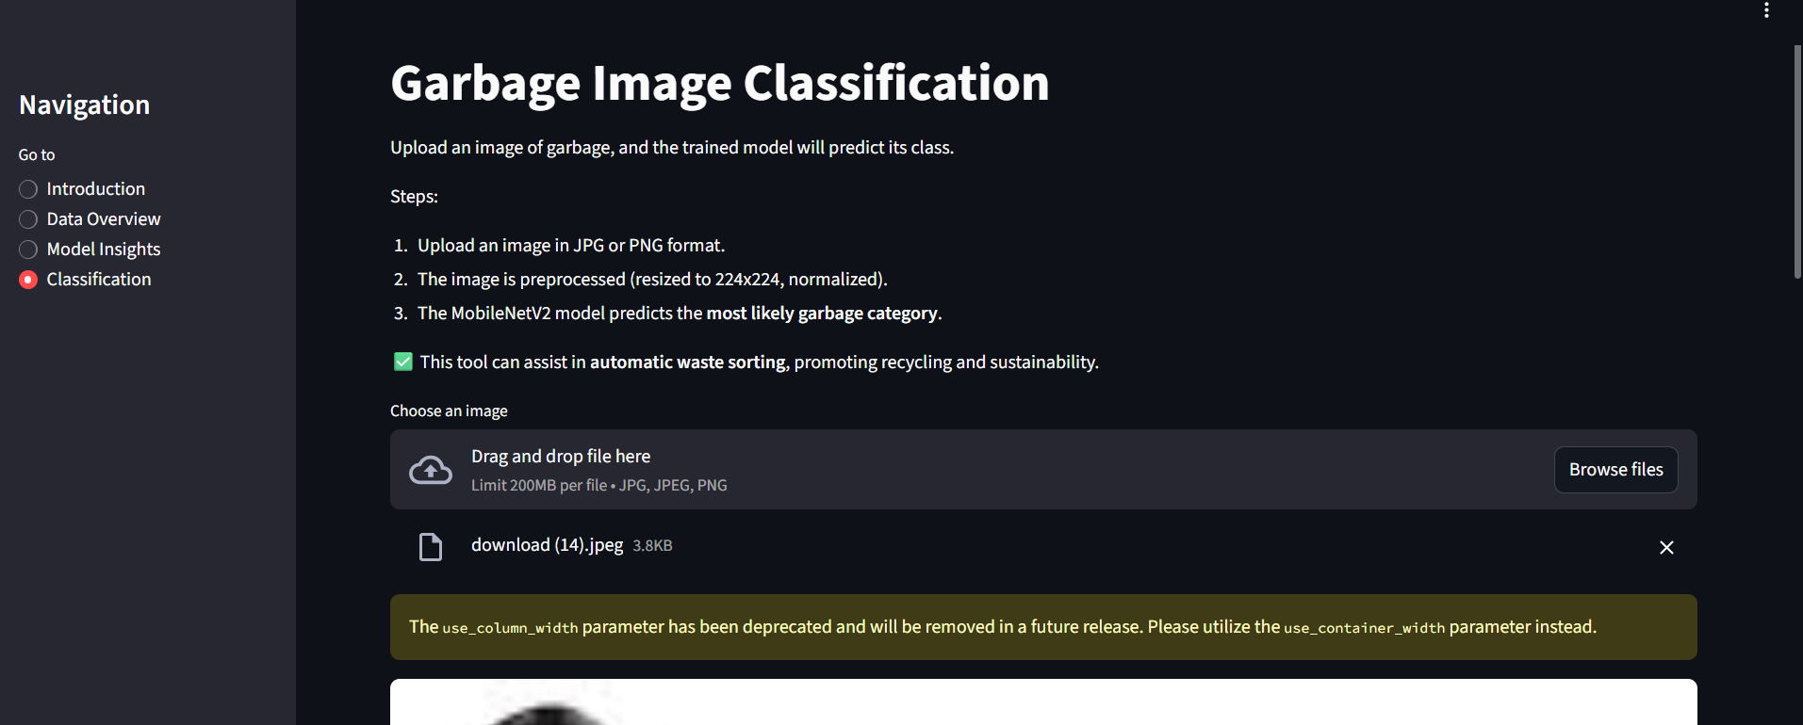
Streamlit Dashboard

Slide 8

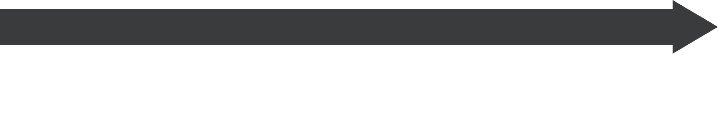

Real-time Waste Classification via Streamlit Web App
To demonstrate the practical utility of our model, a user-friendly web application has been developed, enabling real-time waste classification.
Image Upload
Intuitive Interface
Users can easily upload a garbage image directly through the app's interface for instant analysis.
A robust web application meticulously crafted using Streamlit, designed for an intuitive and seamless user experience.
Cloud Deployment
Live Prediction
The application is deployed within a Google Colab environment, leveraging ngrok to generate a secure, publicly accessible URL.
The uploaded image is processed by the MobileNetV2 model, providing real-time classification predictions.

Slide 9





Core Technologies Powering Our Solution
This project is built upon a robust stack of leading machine learning and web development technologies, ensuring both computational power and user accessibility.
TensorFlow / Keras
PyTorch
Streamlit
Utilised extensively for transfer learning, model building, and deployment functionalities, providing a high-level API for neural networks.
Employed for developing and experimenting with our custom Convolutional Neural Network (CNN) model, known for its flexibility and dynamic computation graphs.
The framework of choice for developing the interactive and user-friendly web application, enabling rapid prototyping and deployment.
Ngrok
Matplotlib / Seaborn
Instrumental in creating secure tunnels from our Google Colab environment, facilitating public access to the Streamlit web application.
Essential tools for data visualisation, plotting training histories, and gaining insights from model performance metrics.

Slide 10

Impactful Outcome: AI-Powered Waste Sorting for a Sustainable Future
This project successfully delivers an innovative, AI-powered system capable of accurately classifying garbage images in real-time. Accessible via an intuitive web interface, it showcases the tangible application of deep learning.
Ultimately, this solution is a significant step towards fostering environmental sustainability and advancing smart waste management practices globally.

